Slide 1
Team 60 Final Project Video Presentation
Modeling and Forecasting Hotel Booking Cancellations

Slide 2
Team Members
Andrea Kirksey
Dakota Coomes
Gurman Singh
Jiangqin Ma
Duarte-Nuno de Sousa

Slide 3
Agenda
Problem Statement/Background/Business Justification/Hypothesis
Exploratory Data Analysis
Analytical Method and Models
Conclusion

Slide 4

Background and Problem Statement
Hotel reservations and cancellations pose a risk to the hotel business often with no financial recourse
Mitigate this risk by modeling and forecasting hotel booking cancellations
Allow hotel businesses to better plan and maximize room utilization
Problem Statement: Determine what factors impact hotel booking cancellations and forecast future bookings

Slide 5

Research Questions
Can hotel booking cancellations be modelled and forecasted using data on booking profiles and time of year?
Are hotel booking cancellations seasonal?
Are hotel booking cancellations affected by hotel profile?
Does group size/make up impact booking cancellation propensity?
Do hotel bookings show an increasing/decreasing trend?
Notes:
Can talk about our hypothesis as answers to these questions in this slide

Slide 6
Initial Hypotheses
Winter cancellations
City hotels vs. Resort hotels
Booking trend
Large groups or families compared to individuals
Notes:
Maybe remove some text and add code snippets here?
Add box plot-Nuno

Slide 7
Exploratory Data Analysis
Data Clean-up (remove Nulls, NA, outliers, similar values)
Correlation Matrix
Correlation matrix revealed high correlation between market segment and distribution channel
Mutations: 'Season' and 'is Domestic' (proved to be significant)
Correlation plots and correlation funnels
City Independent Variables | Cancel Correlation
Deposit type | 0.518
Is Domestic | 0.382
Lead Time | 0.308
Total Special Requests | 0.296
Previous Cancellations | 0.167
Booking changes | 0.151
Required parking spaces | 0.134
Customer Type | 0.118
Resort Independent Variables | Cancel Correlation
Is Domestic | 0.293
Deposit type | 0.271
Required parking spaces | 0.246
Lead Time | 0.228
Market Segment | 0.138
Booking changes | 0.115
Previous Cancellations | 0.114
Total Special Requests | 0.103
Notes:
Deposit type is a highly correlated variable for both hotel types

Slide 8
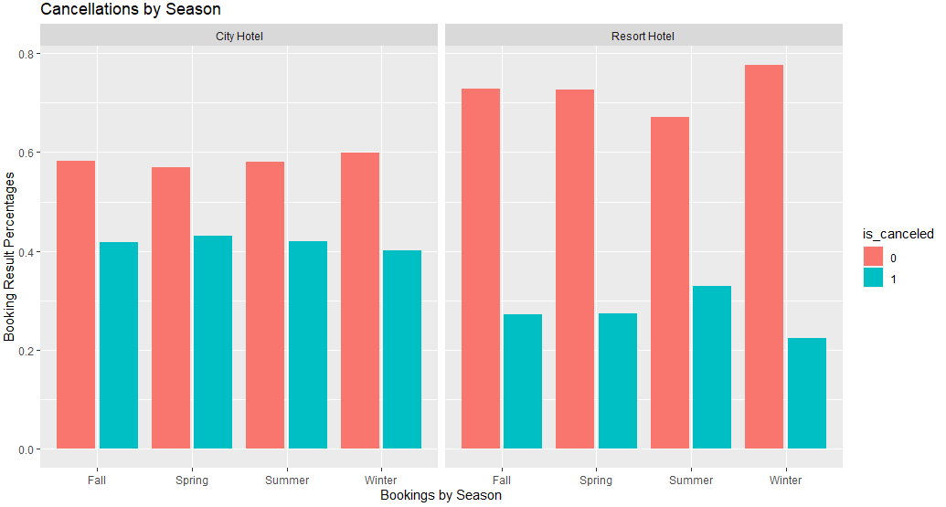
Exploratory Data Analysis cont.
Lowest cancellation rates occurred in winter, counter to one of our hypotheses
The city hotel was subject to higher overall cancellation rates
Notes:
Resort and City Hotels display similar correlations to the dependent variables, but in disproportionate degrees.

Slide 9
Overview of analytical method and models
Logistic regression to determine how parameters affect likelihood of hotel booking cancellation
KNN and SVM model for classification
Holt-Winters forecasting and exponential smoothing to determine periodicity and trend in bookings throughout the year
Notes:
Create a confusion matrix to summarize the classifications
Plot ROC Curve and AUC to analyze sensitivity and specificity with different thresholds
Tune C and K hyper-parameters
Split the dataset into training, validation, test sets. Use predict accuracy to compare the models

Slide 10
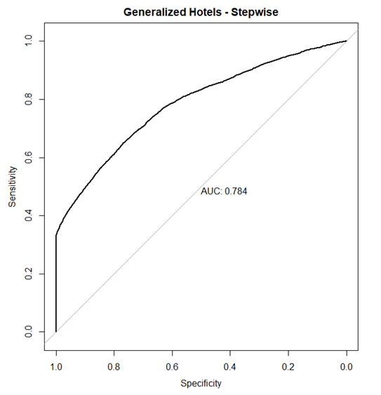
Logistic Regression Model
Similar AUC across city, resort, and generalized hotels (75 – 80%)
Main predictors of booking cancellations:
Non-refundable deposit
Online travel agent
Future analysis
Enhanced feature selection
PCA, elastic net

Slide 11
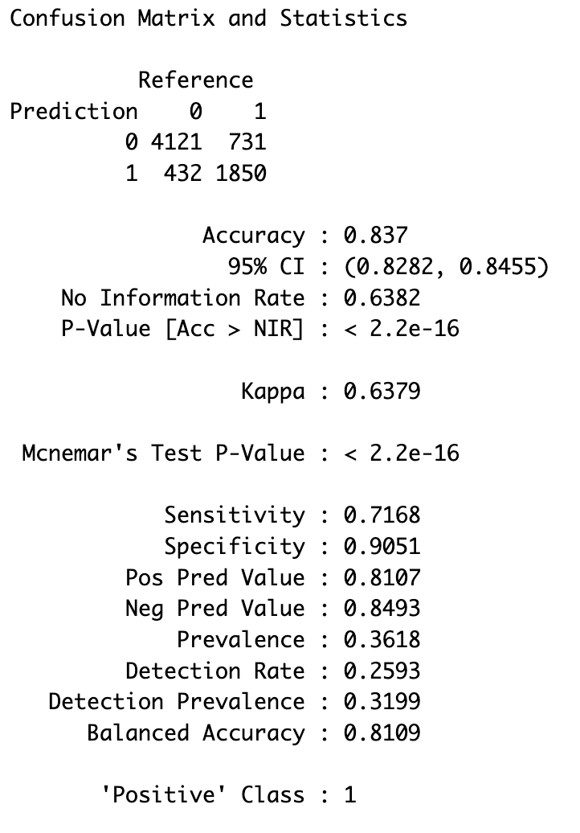
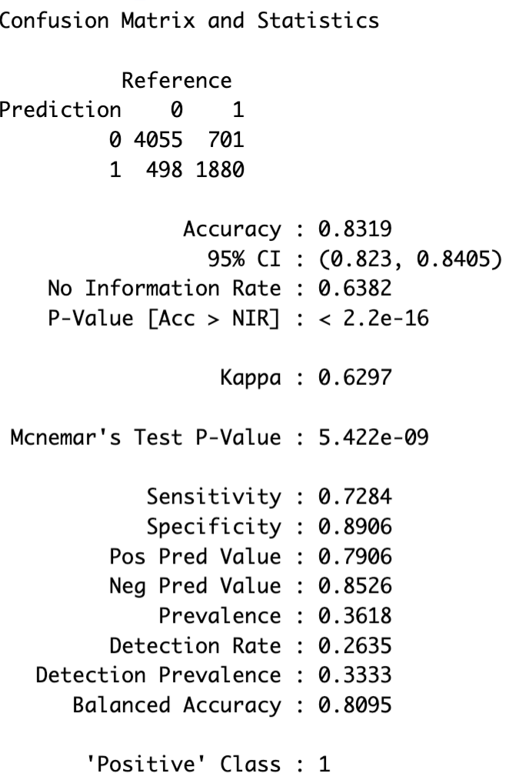
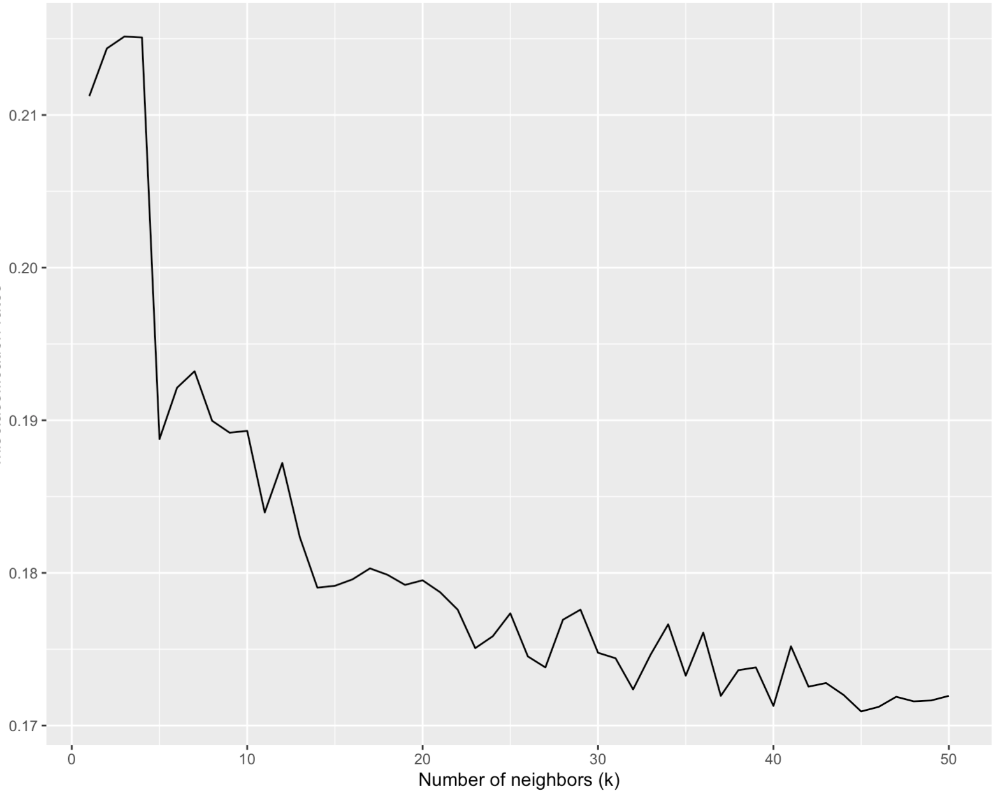
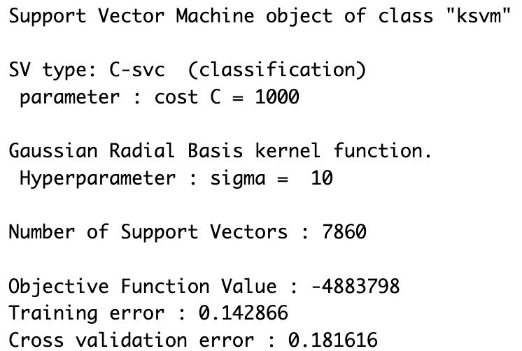
SVM and KNN Model
SVM Model Results:
KNN Model Results:
Confusion Matrix Summary
Confusion Matrix Summary
KNN Misclassification Plot
SVM Model Summary

Slide 12
KNN/SVM/Logistic Regression Model Comparison
Predictive Performance
Accuracy (KNN and SVM)
Similar for both models
Slightly better for KNN
AUC (Logistic regression)
Relatively high
Computational efficiency – hyperparameter tuning
KNN – 4 minutes
SVM – 2 hours
Interpretability
Easy to understand – logistic regression and KNN
Hard to understand – SVM (due to nonlinear/nonparametric kernel)

Slide 13
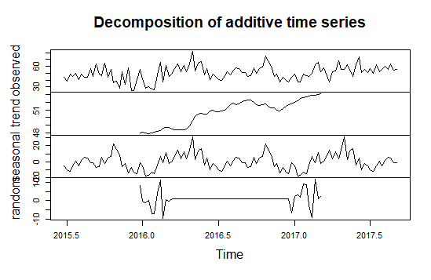
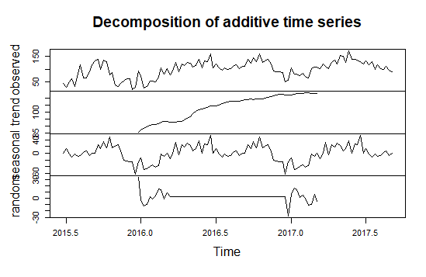
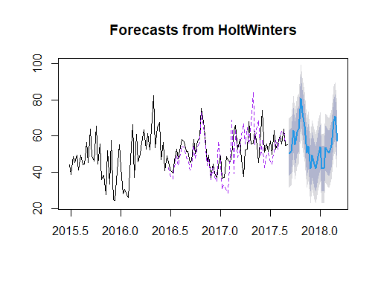
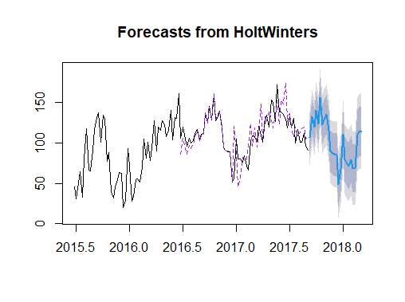
Holt-Winters Model
Error for forecast is moderately high due to the limited timespan in our reference dataset

Slide 14
Conclusion
Best models for modeling predicting hotel booking cancellations
Logistic Regression and KNN
Easier to implement and optimize
High booking cancellation rate for City Hotels vs. Resort Hotels
Family size/children did not have significant effect on booking cancellations
Observed an increasing trend in bookings. Forecast bookings up to 6 six months with 95% confidence level
Hotel booking data analysis can help businesses with:
Pricing, resource allocation, risk management etc.
On-going research focuses on short-term(4-5 days) booking cancellation prediction
Further research with more predictors such as weather and competitive intelligence

Slide 15
References
Antonio, N., de Almeida, A . M., & Nunes, L. (2017). Predicting Hotel Booking Cancellation to Decrease Uncertainty and Increase Revenue. Tourism & Management Studies, 13(2), 25–39. https://doi.org/https:// www.researchgate.net/publication/310504011_Predicting_Hotel_ Booking_Cancellation_to_Decrease_Uncertainty_and_Increase_Revenue
Falk, M., & Vieru, M. (2018). Modelling the cancellation behaviour of hotel guests. International Journal of Contemporary Hospitality Management, 30 (3). https://doi.org/ https://www.researchgate.net/publication/326824252_Modelling_the _cancellation_ behaviour_of_hotel_guests
Sánchez, E. C., Sánchez-Medina, A . S.-M. J., & a Pellejero, M. (2020). Identifying critical hotel cancellations using artificial intelligence. Tourism Management Perspectives, 35. https://doi.org/https:// www.sciencedirect.com/science/article /abs/ pii /S2211973620300854

Slide 16
Thank You

